Slide 1
Car Insurance Modeling

Slide 2
What is the problem?
Our project aims to create a model which helps an insurance company decide what rate to charge new customers
Our goal is to have our model predict whether a customer will file a claim
A customer's rank can change depending on whether the model predicts they will file a claim or not
Customers will be charged a rate based on their rank

Slide 3
The Data Set
The data set contains 1000 rows and 19 columns of customer demographic information as well as vehicle type and driving behavior information
Our target variable is whether or not someone filed a claim (identified in the “OUTCOME” column by a factor of 0 or 1)
Our data set was imbalanced - 6,867 did not submit a claim, while 3,133 did

Slide 4
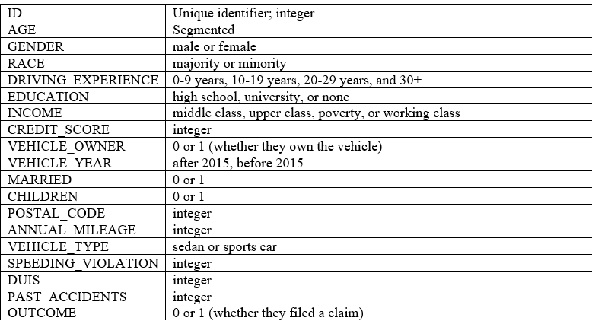
The Data Set

Slide 5
Data Analysis
Correlations
Filed
Not Filed
We found that "ZIP_CODE" and "RACE" did not correlate
Most had between 0-9 years of driving experience and fell within the "poverty" category
Most had between 10-19 years of driving experience and were upper- class

Slide 6
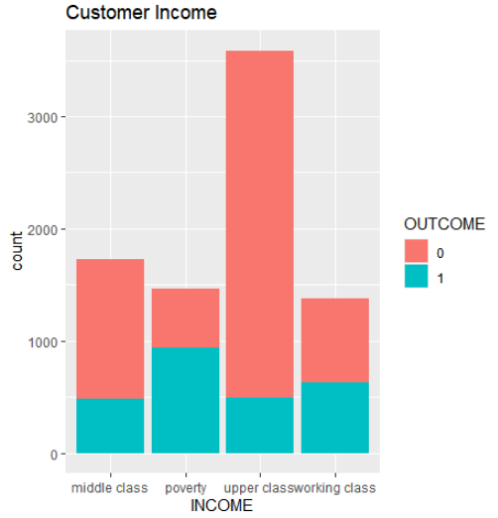
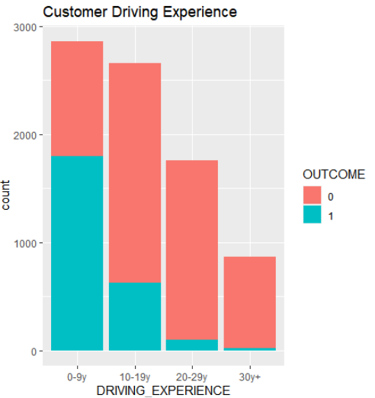
Data Visualization
Higher income customers are less likley to submit a claim
Customers with more driving experience are less likely to submit a claim

Slide 7
Preprocessing
We removed "GENDER" and "RACE" variables to minimize bias
We removed the "ID" column and an additional 1,939 rows that contained missing information
We added a column for rank so that customers with no accident were ranked "good", customers with 1 accident were ranked "okay", and customers with more than 1 accident were ranked "bad"
After preprocessing there were 16 columns and 8,149 variables (5,613 did not submit a claim, while 2,536 did)

Slide 8
OUR MODELS
Decision Tree
Naive Bayes

Slide 9
Decision Tree
ACCURACY
BALANCED ACCURACY
83%, which was better than the no information rate of 68%
83%, the same as total accuracy
SENSITIVITY
PRECISION
83%, the model was good at classifying "no claims" correctly
83%, the model was good at classifying "claims" correctly

Slide 10
Fine Tuning
For our project is was more important for us to accurately identify claims
We tuned the model to place more weight on classifying claims

Slide 11
Fine Tuning
76%
93%
68%
Total and balanced (80%) accuracy decreased
Accuracy increased for precision
Accuracy decreased for sensitivity

Slide 12


Confusion Matrix
 |  | Actual
Predicted
2297
102
1070
1419

Slide 13
Naive Bayes
ACCURACY
BALANCED ACCURACY
76%, which was better than the no information rate of 68%
74%, which is less than the total accuracy
SENSITIVITY
PRECISION
89%, the model was good at classifying "no claims" correctly
59%, the model was good at classifying "claims" correctly

Slide 14
Conclusion
1
The Decision Tree model out-performed the Naive Bayes model
2
Before tuning: driving experience, vehicle ownership, and age had the greatest impact
3
After tuning: driving experience, age, and past accidents had the greatest impact

Slide 15
Thank You!

